Slide 1


Level Up Your Literature Search: PubMed and Embase Essentials
Sharon Duffy, MLIS
Research Services Librarian
School of Medicine Liaison Librarian
sduffy@lsuhsc.edu
June 2026

Slide 2
Objectives
Searching for research vs clinical applications
Literature review overview
Databases vs Google Scholar vs AI tools
PubMed search demo
  Sample search in PubMed
  MeSH terms in Medline
  Boolean operators
Translate search from PubMed to Embase
Using Limits and Filters to refine your search

Slide 3
Goals of Searching

Slide 4
Searching in
Clinical vs. Research Applications
Clinical
Support patient care decisions
Focus on treatment, diagnosis, safety, patient outcomes
Prioritize evidence that can immediately influence clinical practice
Need quick answers to proceed
Research
Support scientific inquiry and experimental design
Focus on understanding scientific landscape
Goal is comprehensive and thorough review of existing literature
Need depth of information to proceed
Tools
DynaMed, ClinicalKey, PubMed
Tools
PubMed, Embase, CINAHL, Web of Science

Slide 5
Searching for Research
Literature Reviews
Comprehensive survey, analysis, and synthesis of existing scholarly literature on a specific topic
Integrate concepts, theories, and historical context
Can be an entire article or a section of an article
Can be influenced by author’s biases because there is no systematic design
Systematic & Scoping Reviews
Robust research outputs
Use structured, transparent, and reproducible methods to remove bias
Include comprehensive searches in multiple databases
Require inclusion of a Librarian to ensure thorough and deep literature search
Today’s focus

Slide 6
Purpose of a Literature Review
Establish
Establish the Scientific Context
Understand current state of knowledge on a topic
Avoid repeating studies that have already been done
Situate your study within the broader scientific conversation
Identify
Identify Knowledge Gaps
Highlight conflicting findings from past research
Reveal unanswered questions
Justify why your research is needed
Support
Support Hypothesis Development
Strong hypothesis is grounded in data and theory
Construct a hypothesis that is testable, specific, and relevant
Improves strength of methodology and findings

Slide 7
Scholarly Databases

Slide 8
Scholarly Literature Databases
Database
Curated collection of journals
Articles are indexed
Designed for easy retrieval
No database includes all journals
You need to search multiple databases to more fully cover a topic.
Google and Google Scholar are NOT databases. They are search engines.
AI tools are not appropriate for research.

Slide 9
Databases vs Google Scholar vs AI Tools
Feature | Scholarly Databases | Google Scholar | AI Tools
Content Source | Curated journals, discipline specific | Broad, academic, from internet sources | Mixed training data; not fully known
Quality Control of Contents | High; strict indexing standards | Variable; lesser quality articles can be found | Variable; Responses based on patterns
Coverage Depth | Deep, discipline-specific | Broad, interdisciplinary | Unclear and incomplete
Search Reproducibility | High; can be saved, exported, repeated | Moderate; based on algorithm and user | Not reproducible
Search Precision | Advanced; Filters; Controlled vocabulary | Basic keywords | Natural language
Ease of Use | Training required to maximize | Very easy | Very easy
Misinformation Risk | Low | Moderate | High with hallucinations
Systematic Reviews | Gold standard | Not sufficient | Not appropriate
Notes:
Bottom line:
Biomedical databases are the best option for research searches because they combine high-quality, curated content with precise, transparent, and reproducible search capabilities—features that Google Scholar and AI tools cannot fully provide.

Slide 10








Recommended Databases to Get Started
Biomedical
Multi-disciplinary
Subject Specific
Today’s focus
Today’s focus

Slide 11
Questions?

Slide 12
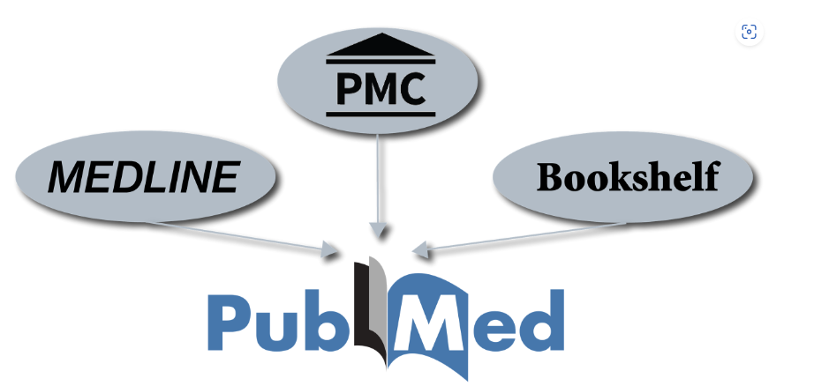
What is in PubMed?
PubMed
  Medline + PubMed Central + Bookshelf
Medline
  Primary database of PubMed
  Over 5000 journals rigorously selected for inclusion
  Records indexed with MeSH terms
PubMed Central
  Repository for articles to meet funder requirements
  Digital counterpart to NLM print collection
PubMed coverage includes:
Biomedicine
Public Health
Health Fields
Health Policy
Life Sciences
Behavioral Sciences
Medical Education
And much more

Slide 13

What is in Embase?
Embase
  99% of Medline journals + 3000 more
  15,000 conferences covered
  More international coverage than Medline
  More pharmacology, drugs, and medical device emphasis
  Indexed with Emtree terms
  Product of Elsevier

Slide 14
Searching in PubMed

Slide 15
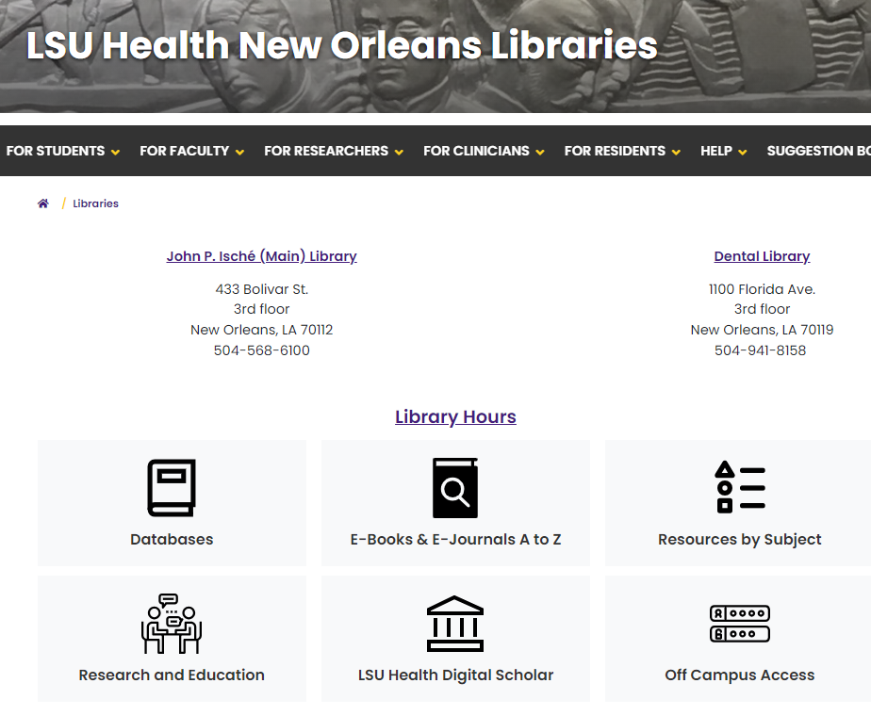
Accessing PubMed
Pubmed.gov is the direct URL to start searching.
Can also access from the Library website – lsushc.edu/library
Recommended to establish off-campus access before searching so you will see the articles in our collection.

Slide 16
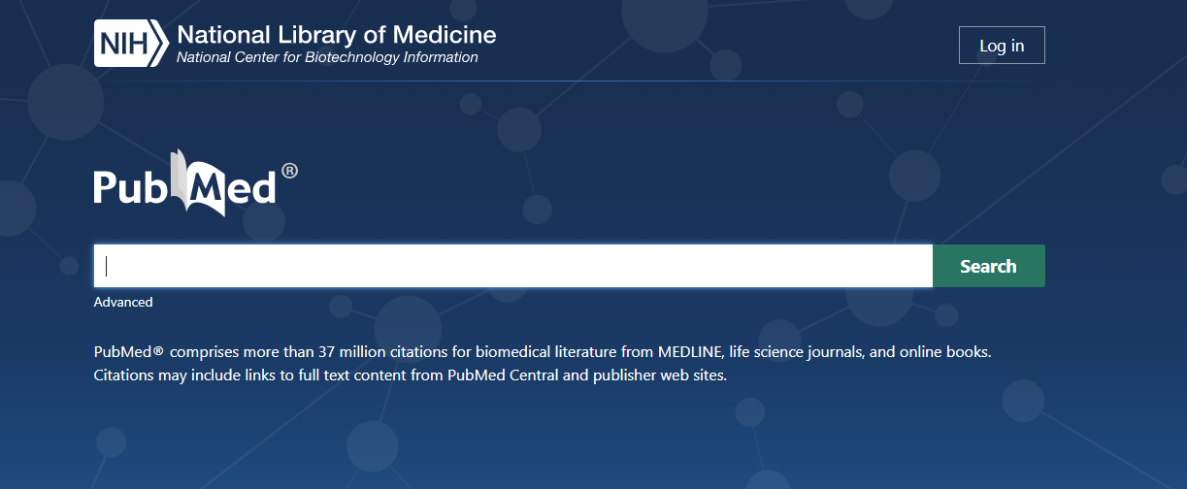
Topic Searching in PubMed
PubMed searches much more than the words you type.
It does a lot of term matching in the background to expand your results.
Start by typing in your topic
Be as specific as possible
Use more than one concept
Autocomplete feature shows suggestions
No punctuation or quotation marks
No Boolean operators (AND, OR)

Slide 17
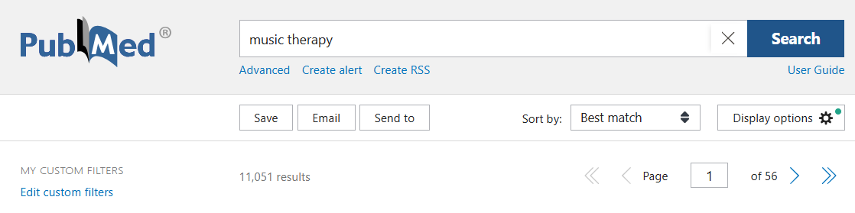
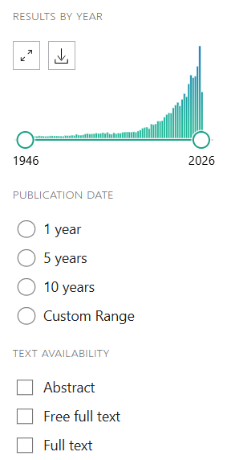
Sample PubMed Search
Example: Music therapy for children with autism
Sorted by Best Match
Filters can limit by year, article type
Options to save results, email articles
Need My NCBI account for some features

Slide 18
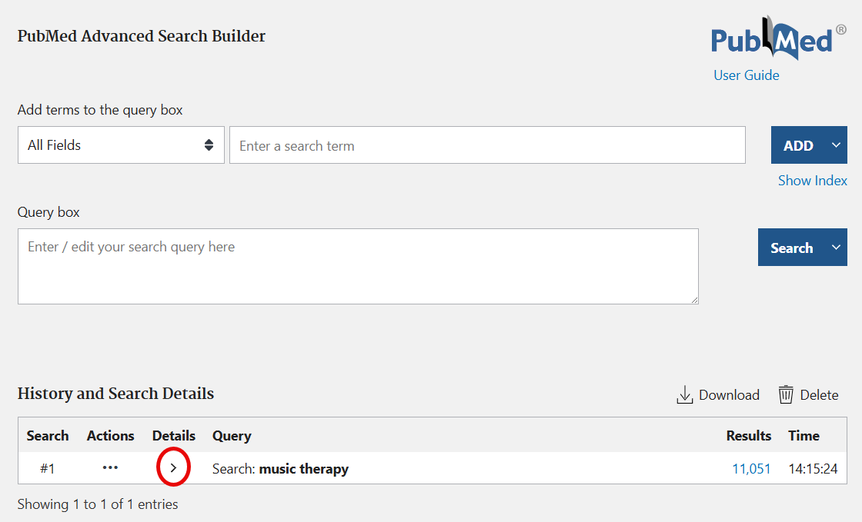

Go to Advanced Search Page
Example: Music therapy for children with autism
Click Advanced to see exactly what PubMed searched
Then click the arrow under Details to open up the details of our search

Slide 19
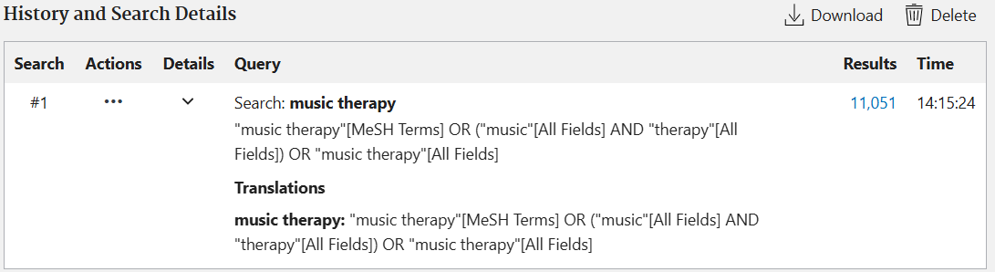
Closer Look at PubMed Search for Music Therapy
MeSH Terms are Medical Subject Headings in Medline.
PubMed automatically searches a combination of MeSH terms and keywords.

Slide 20
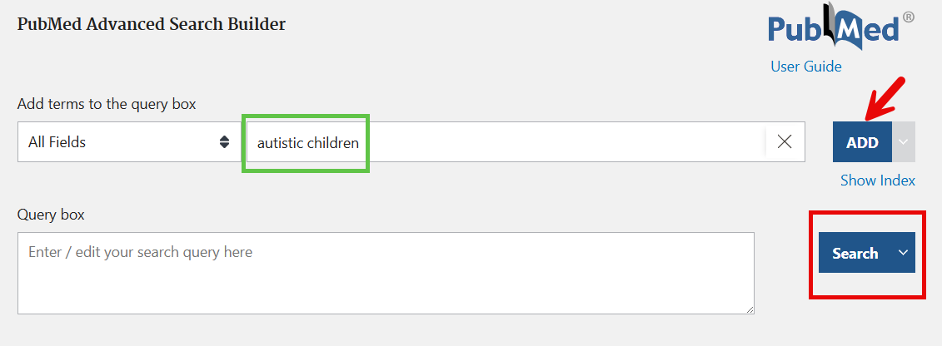
Add terms to PubMed Search
Example: Music therapy for children with autism
Add terms to Advanced Search Builder -> Click Add -> Click Search button

Slide 21
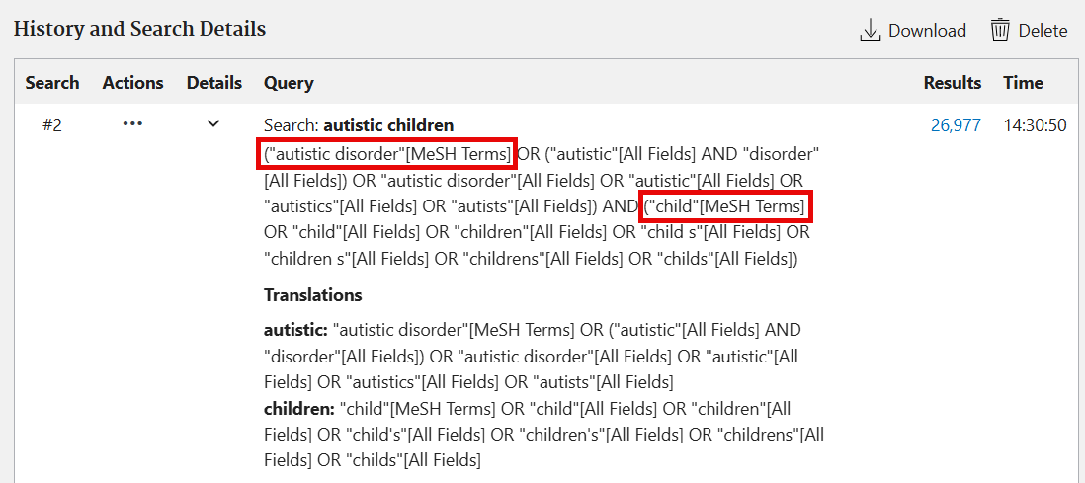
Closer Look at PubMed Search
PubMed identified Autistic Disorder and Child as the MeSH terms for my entry words.
Added keyword searches for variations of the terms.
Combined with AND

Slide 22
What is MeSH?
Some databases have a controlled vocabulary thesaurus to give uniformity and consistency to the biomedical literature
Allow better searching because article must be indexed/tagged with the topic to be retrieved
Only Medline articles are indexed with MeSH terms
MeSH terms were originally assigned by indexers at NLM but now they are done by AI
Databases with Subject Headings:
Medline uses MeSH (Medical Subject Headings).
Embase uses Emtree.
CINAHL
Databases without Subject Headings:
Scopus
Web of Science

Slide 23
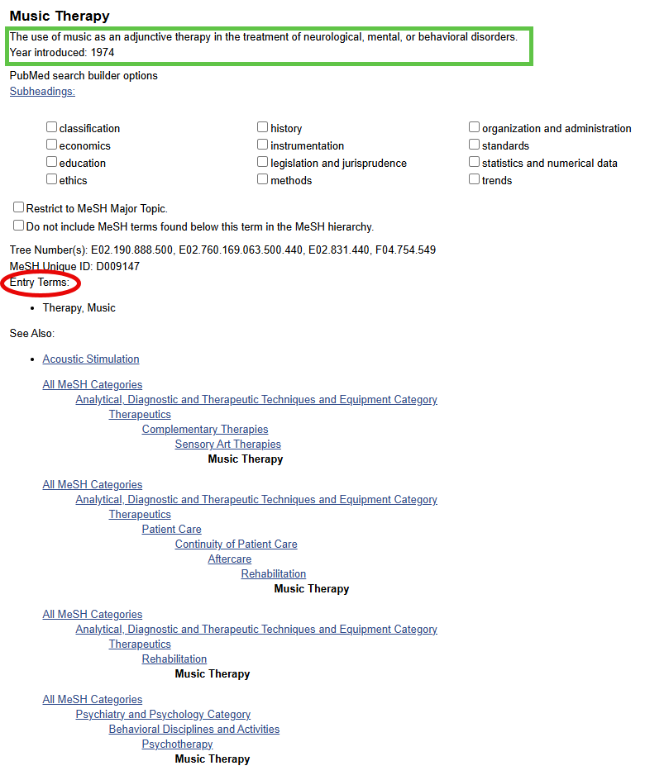
More About MeSH
Music Therapy MeSH Page
Definition of term
Subheadings to narrow search
Entry terms are synonyms that will point to this MeSH term
Tree hierarchy to see how term is mapped in MeSH
There is a separate MeSH database that can be used to identify terms and view the hierarchies.
Useful page for explaining more details about MeSH

Slide 24
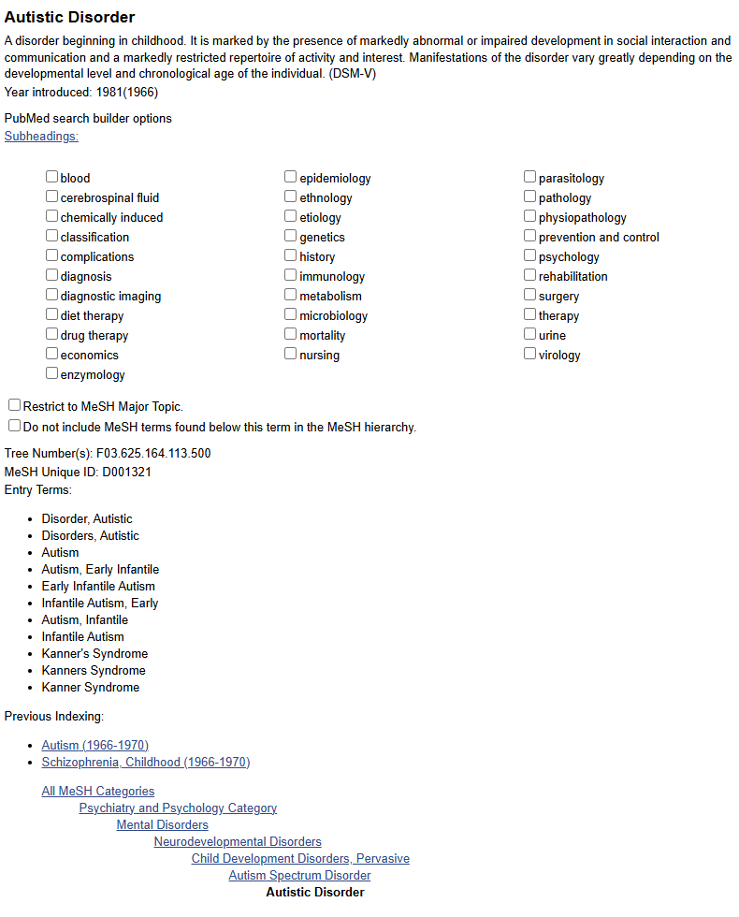
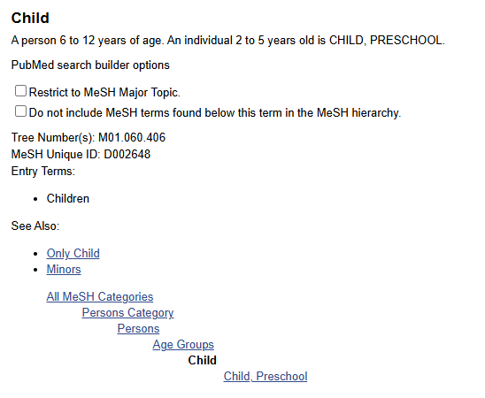
MeSH pages for
Autistic Disorder and Child

Slide 25
Boolean operators

Slide 26
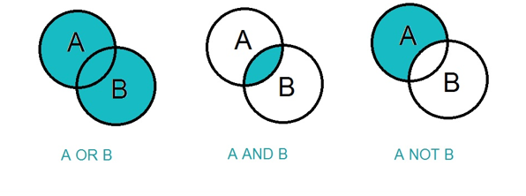
Overview of Boolean Operators
The three basic Boolean operators are AND, OR, and NOT.
Use them to:
connect your search words together to either narrow or broaden your set of results
focus a search, particularly when your topic contains multiple concepts
OR is used for synonyms and similar terms for naming the same concept.
Ex: cat OR feline; dog OR canine
It will broaden a search.
AND is used to combine concepts.
Ex: cat AND dog requires articles to contain both concepts to be retrieved.
It will narrow a search.

Slide 27
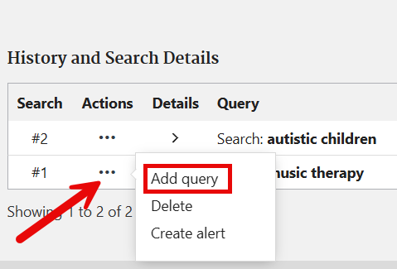
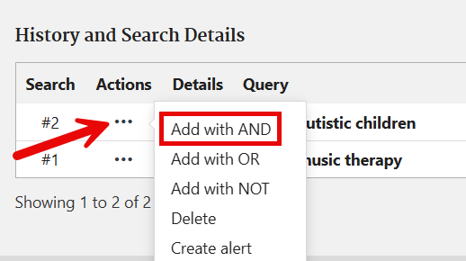
Using Boolean Operators in PubMed
Let’s combine Music Therapy results AND Autistic Children results
On the Advanced Search Page:
Step 1: Click dots in Music Therapy results and select Add query
Step 2: Click dots in Autistic Children results and select Add with AND

Slide 28

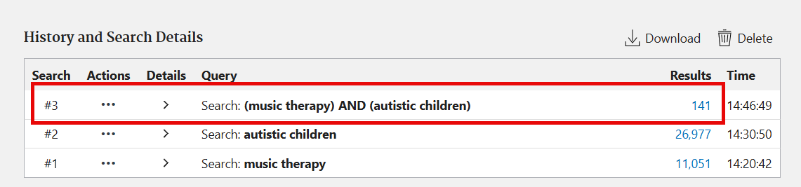
Results of Combined Search
Now there are 141 articles that include both of our topics.

Slide 29
Searching in Embase

Slide 30
Accessing Embase
Access from the Library website – lsushc.edu/library
Recommended to establish off-campus access before searching so you are connected with our subscription.
Go to the Databases A to Z list. Click E and then go to Embase.
Similar to PubMed, you’ll want to create a personal account to save searches, results, etc.

Slide 31
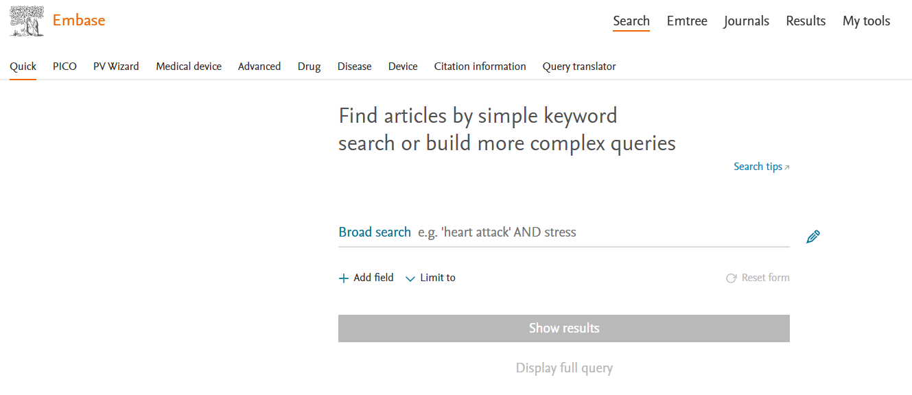
Translate Search from PubMed to Embase
Use Query Translator tool in Embase
Tool is not perfect but usually a provides a comparable search and finds additional relevant articles.

Slide 32
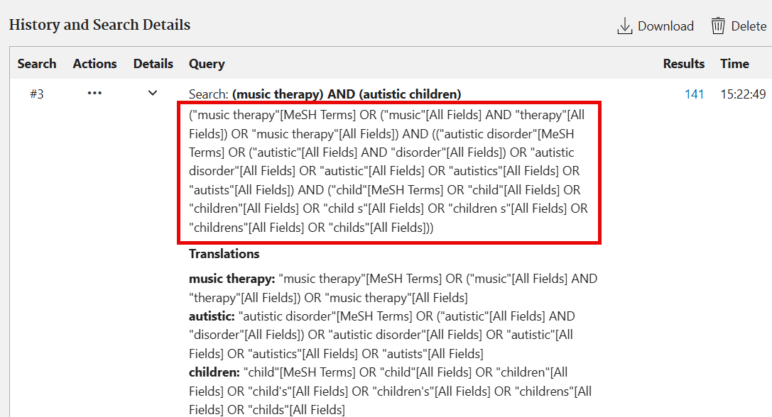
Copying the PubMed Search
Need to copy the detailed PubMed search
Embase will understand these tags and translate them

Slide 33
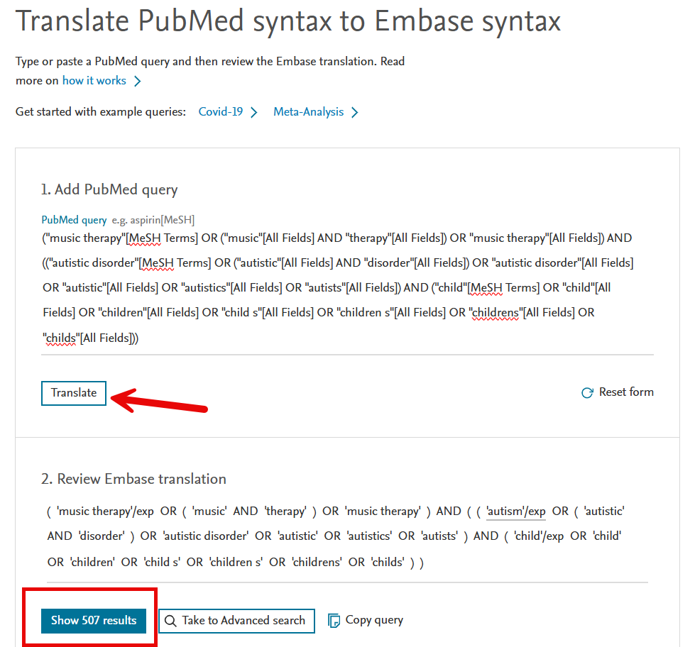
Translation
Paste in the PubMed search and click on Translate button
Embase usually has more results than PubMed due to searching full-text of articles and additional indexing of terms.

Slide 34
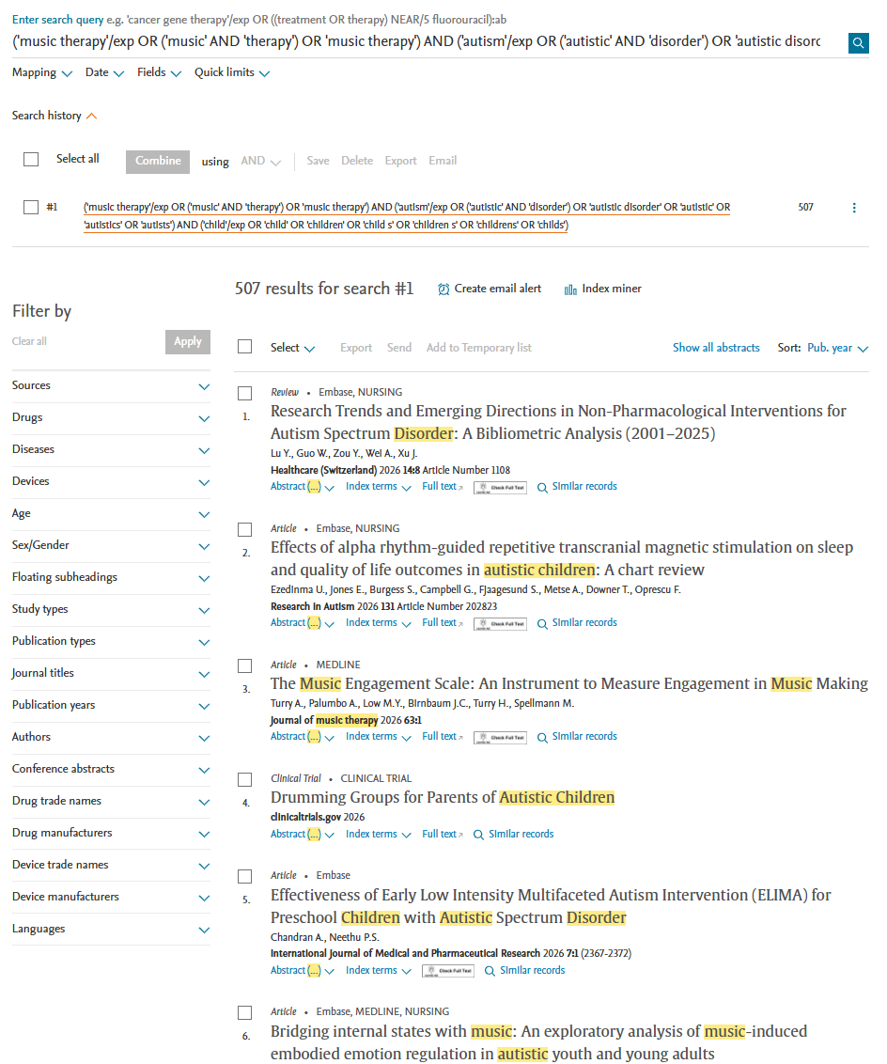
Viewing Embase Results
Additional filters available compared to PubMed.
Terms from search strategy are highlighted in results for quick identification.
Default sort order is usually Publication Year; can change to Relevance or Author Name.

Slide 35
Limits and filters

Slide 36
Using Limits and Filters
Narrow your search results by applying limits and filters to the result set.
Be careful to not overuse limits and filters and accidentally eliminate relevant articles.
Embase utilizes more extensive indexing to articles.
Embase searches full-text of articles so may need to limit search to title/abstract/keyword fields.
Only Medline articles use filters so all PMC articles will be eliminated when you apply a filter. (Publication year will be applied to all articles.)
Generally - do not use Free Full Text filter in PubMed - our collection is very extensive!

Slide 37
Key Takeaways
Search PubMed and Embase databases to cover majority of biomedical literature
  Query Translator tool in Embase makes it easy
Search using a combination of subject headings and keywords
Consult a Librarian for assistance with building a robust search
  Essential for Systematic and Scoping Reviews
Scholarly databases will provide the highest quality literature and best search tools

Slide 38
Resources for Searching
Link to Library Homepage: https://www.lsuhsc.edu/library/
Link to PubMed on Databases page: https://www.lsuhsc.edu/library/databases/pubmed.aspx
Link to Embase on Databases page: https://www.lsuhsc.edu/library/databases/embase.aspx
Link to new Resource Guide for Searching PubMed: https://libguides.lsuhsc.edu/pubmed
  Includes how to create My NCBI account
Link to PubMed Training and Embase User Guide

Slide 39
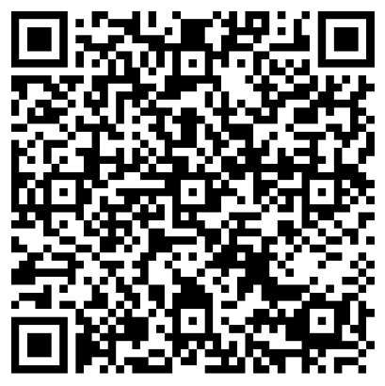

Contact Information
Sharon Duffy, MLIS
sduffy@lsuhsc.edu
Research Services Librarian
School of Medicine Liaison
Systematic Review Librarin
Data Services Librarian
Survey (Very short!)
Help us collect metrics!
Sign up for Library Emails!
Library Contact info:
Email: reference@lsuhsc.edu
Phone: 504-568-6100
Library Webpage: lsuhsc.edu/library

