Slide 1
Intro to ProQuest Nursing and Allied Health
Chandler Smith, MA (he/him)
Education Librarian
School of Allied Health Professions Liaison
07/15/2026

Slide 2

Objectives
How to access ProQuest Nursing and Allied Health through Libraries website
Live search demo featuring:
Basic search
Advanced search
Filters
How to create an account
Exporting citations

Slide 3
ProQuest Nursing and Allied Health
What does it contain?
Content focused on Nursing and Allied Health Subjects, including dissertations and theses on those topics. 1,800+ scholarly journals
Also contains clinical Nursing Skills Videos, and royalty-free scientific images

Slide 4
How It Differs from ProQuest
Different from ProQuest, which includes the Nursing and Allied Health collection, but also includes:
Coronavirus Research Database, Dissertations & Theses at LSU Health New Orleans, Education Research Index, ProQuest Dissertations & Theses, and Publicly Available Content Database

Slide 5
Live Demo
Let’s jump in and take a look at ProQuest Nursing and Allied Health!

Slide 6

Questions?

Slide 7
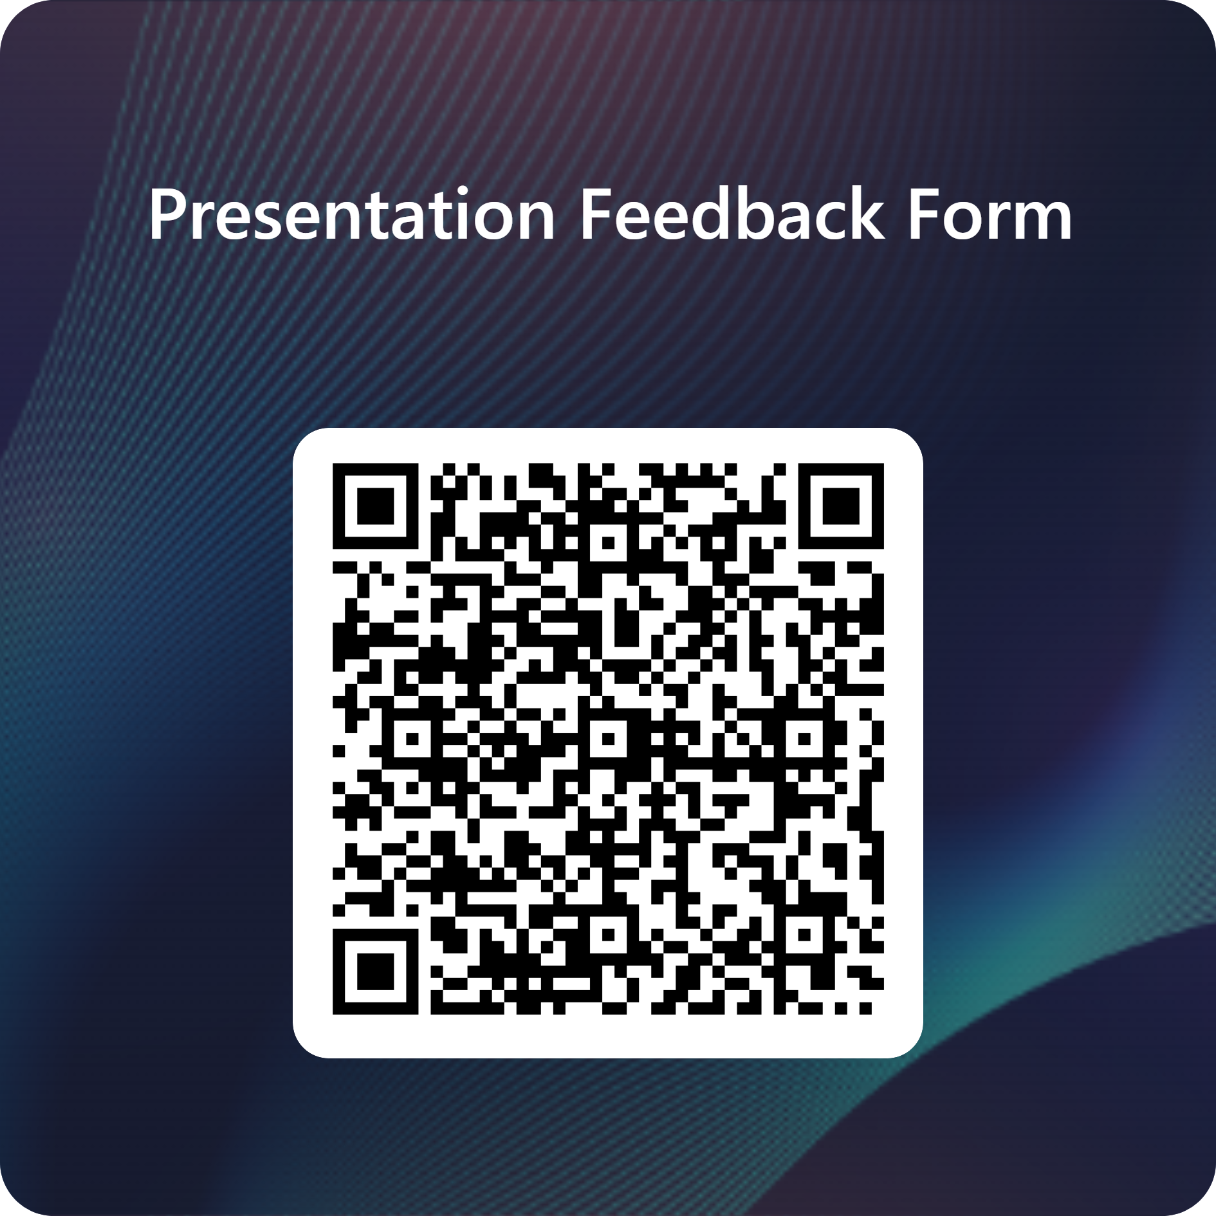

Thank you for joining us!
Visit us on the web at:
https://www.lsuhsc.edu/library/
Questions? Contact us at:
reference@lsuhsc.edu or call 504-568-6100
Complete our Survey!
We’re on Instagram!

